Slide 1
Dunning-Kruger Effect
KRUGER, J. and D. DUNNING, 1999. Unskilled and unaware of it: How difficulties in recognizing one's own incompetence lead to inflated self- assessments. Journal of personality and social psychology, 77(6), 1121-1134
http://dx.doi.org/10.1037/0022-3514.77.6.1121

Slide 2
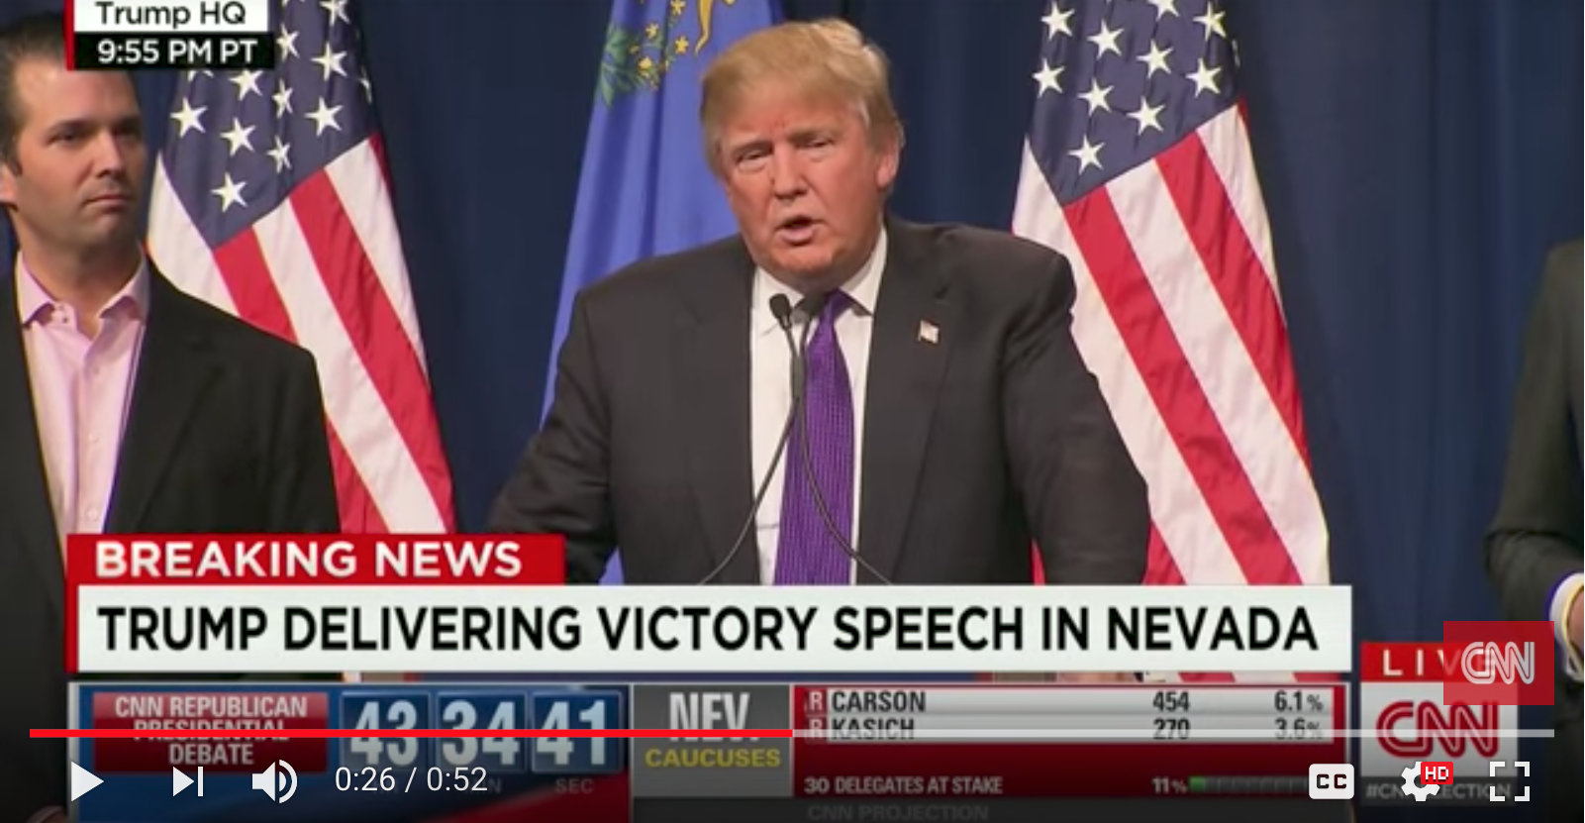
“I love the poorly educated”
(Donald Trump 2016)
THEGUARDIAN.COM., 2016. Donald Trump cements frontrunner status after big win in Nevada. [viewed December 14 2017 ] Available from: https://www.theguardian.com/us-news/2016/feb/23/donald-trump-wins-nevada-caucuses-results
Notes:
https://youtu.be/O9F6EAMPky4?t=23s

Slide 3

Notes:
In 1995, McArthur Wheeler walked into two Pittsburgh banks
and robbed them in broad daylight, with no visible attempt at
disguise. He was arrested later that night, less than an hour after
videotapes of him taken .from surveillance cameras were broadcast on the 11 o'clock news. When police later showed him the surveillance tapes, Mr. Wheeler stared in incredulity. "But I wore the juice," he mumbled. Apparently, Mr. Wheeler was under the impression that rubbing one's face with lemon juice rendered it invisible to videotape cameras (Fuocco, 1996).

Slide 4

Notes:
In 1995, McArthur Wheeler walked into two Pittsburgh banks
and robbed them in broad daylight, with no visible attempt at
disguise. He was arrested later that night, less than an hour after
videotapes of him taken .from surveillance cameras were broadcast on the 11 o'clock news. When police later showed him the surveillance tapes, Mr. Wheeler stared in incredulity. "But I wore the juice," he mumbled. Apparently, Mr. Wheeler was under the impression that rubbing one's face with lemon juice rendered it invisible to videotape cameras (Fuocco, 1996).

Slide 5

Notes:
In 1995, McArthur Wheeler walked into two Pittsburgh banks
and robbed them in broad daylight, with no visible attempt at
disguise. He was arrested later that night, less than an hour after
videotapes of him taken .from surveillance cameras were broadcast on the 11 o'clock news. When police later showed him the surveillance tapes, Mr. Wheeler stared in incredulity. "But I wore the juice," he mumbled. Apparently, Mr. Wheeler was under the impression that rubbing one's face with lemon juice rendered it invisible to videotape cameras (Fuocco, 1996).

Slide 6

Notes:
In 1995, McArthur Wheeler walked into two Pittsburgh banks
and robbed them in broad daylight, with no visible attempt at
disguise. He was arrested later that night, less than an hour after
videotapes of him taken .from surveillance cameras were broadcast on the 11 o'clock news. When police later showed him the surveillance tapes, Mr. Wheeler stared in incredulity. "But I wore the juice," he mumbled. Apparently, Mr. Wheeler was under the impression that rubbing one's face with lemon juice rendered it invisible to videotape cameras (Fuocco, 1996).

Slide 7

Notes:
In 1995, McArthur Wheeler walked into two Pittsburgh banks
and robbed them in broad daylight, with no visible attempt at
disguise. He was arrested later that night, less than an hour after
videotapes of him taken .from surveillance cameras were broadcast on the 11 o'clock news. When police later showed him the surveillance tapes, Mr. Wheeler stared in incredulity. "But I wore the juice," he mumbled. Apparently, Mr. Wheeler was under the impression that rubbing one's face with lemon juice rendered it invisible to videotape cameras (Fuocco, 1996).

Slide 8
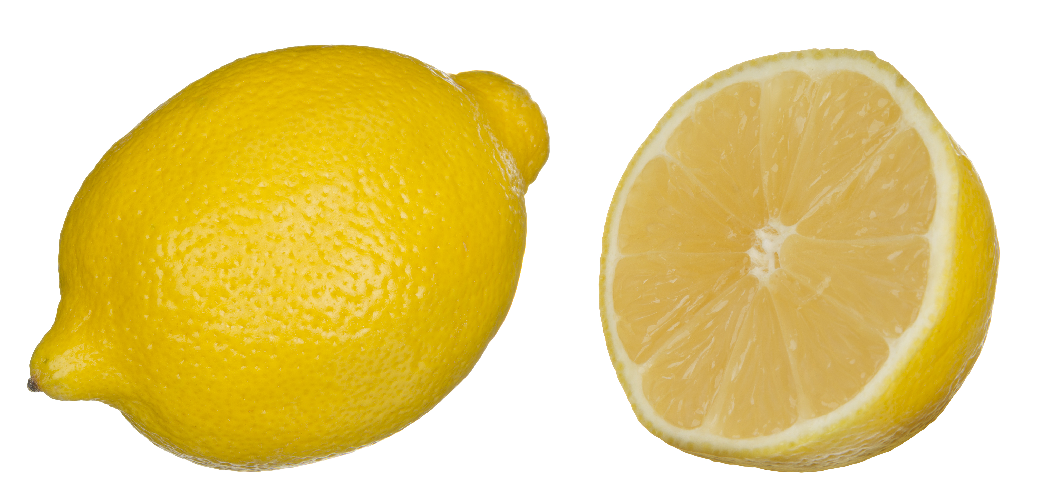
Notes:
In 1995, McArthur Wheeler walked into two Pittsburgh banks
and robbed them in broad daylight, with no visible attempt at
disguise. He was arrested later that night, less than an hour after
videotapes of him taken .from surveillance cameras were broadcast on the 11 o'clock news. When police later showed him the surveillance tapes, Mr. Wheeler stared in incredulity. "But I wore the juice," he mumbled. Apparently, Mr. Wheeler was under the impression that rubbing one's face with lemon juice rendered it invisible to videotape cameras (Fuocco, 1996).

Slide 9
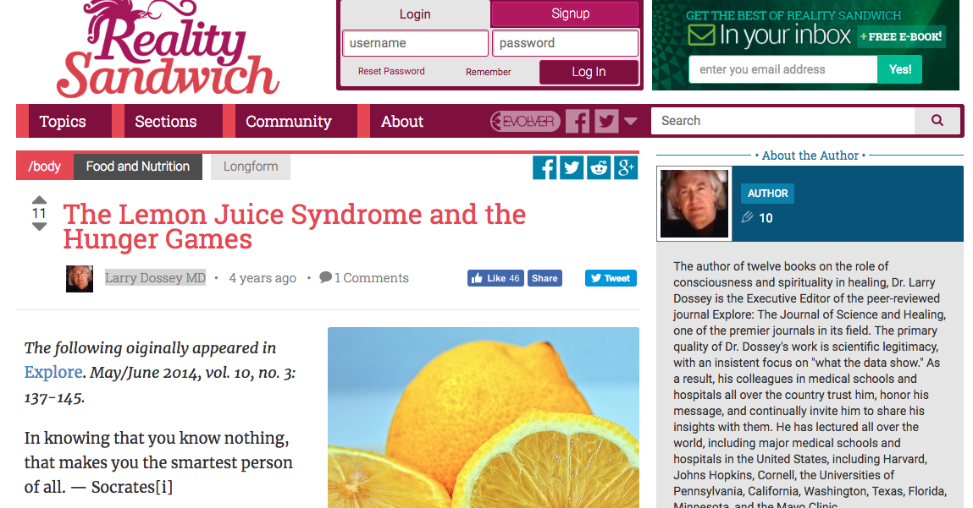
DOSSEY., L. 2014. The Lemon Juice Syndrome and the Hunger Games. In: Reality Sandwich. [viewed Sep 21, 2018]. Available from: http://realitysandwich.com/220780/the-lemon-juice-syndrome-and-the-hunger-games/

Slide 10
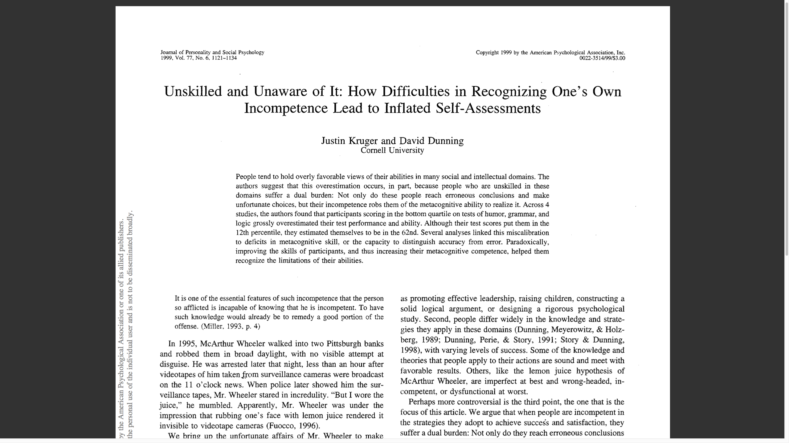

Slide 11
Unskilled and unaware of it: How difficulties in recognizing one's own incompetence lead to inflated self- assessments
(Kruger and Dunning 1999)

Slide 12
People tend to hold overly favourable views of their abilities in many social and intellectual domains.
(Kruger and Dunning 1999)

Slide 13
The authors suggest that this overestimation occurs, in part, because people who are unskilled in these domains suffer a dual burden: Not only do these people reach erroneous conclusions and make unfortunate choices, but their incompetence robs them of the metacognitive ability to realize it.
(Kruger and Dunning 1999)

Slide 14
Across 4 studies, the authors found that participants scoring in the bottom quartile on tests of humour, grammar, and logic grossly overestimated their test performance and ability. Although their test scores put them in the 12th percentile, they estimated themselves to be in the 62nd. Several analyses linked this mis-calibration to deficits in metacognitive skill, or the capacity to distinguish accuracy from error.
(Kruger and Dunning 1999)

Slide 15
Paradoxically, improving the skills of participants, and thus increasing their metacognitive competence, helped them recognize the limitations of their abilities.
(Kruger and Dunning 1999)

Slide 16
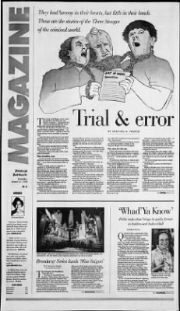
Apparently, Mr. Wheeler was under the impression that rubbing one's face with lemon juice rendered it invisible to videotape cameras
(Fuocco 1996)
FUOCCO, M. A. (1996, March 21). Trial and error: They had larceny in their hearts, but little in their heads. Pittsburgh Post-Gazette, p. Dl

Slide 17
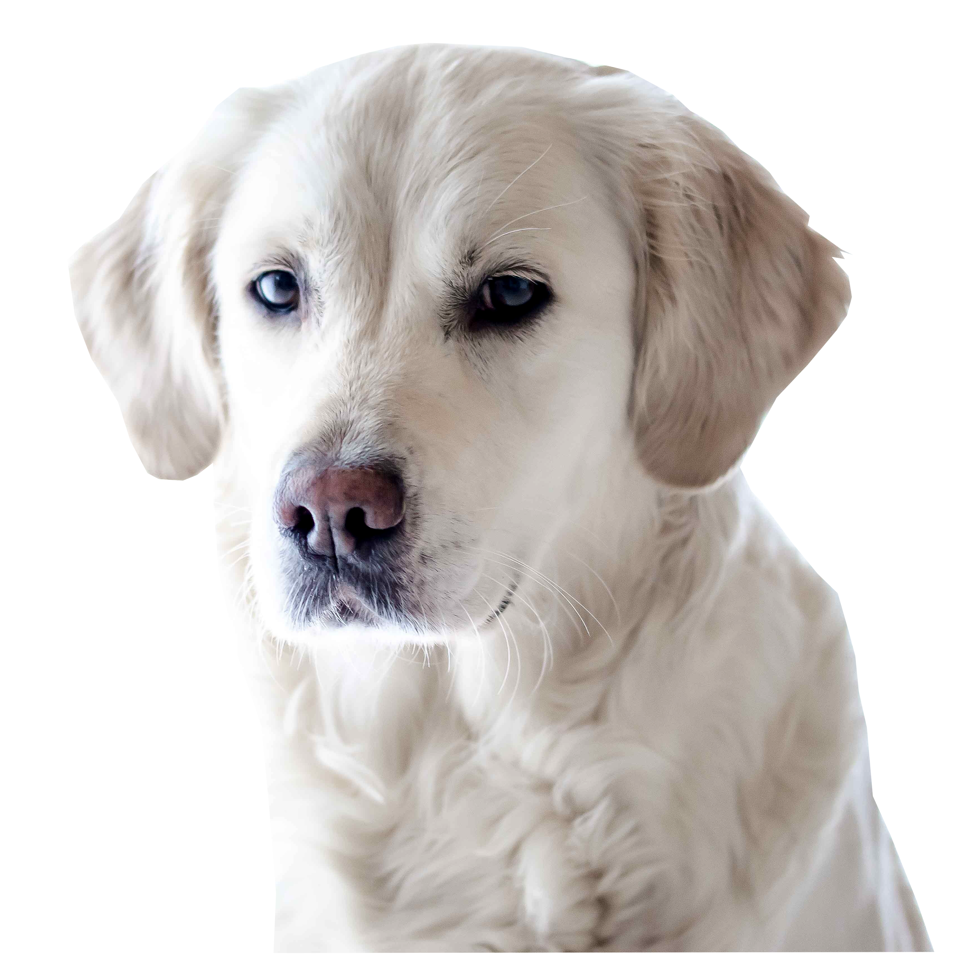
PAVLOV’S DOG

Slide 18
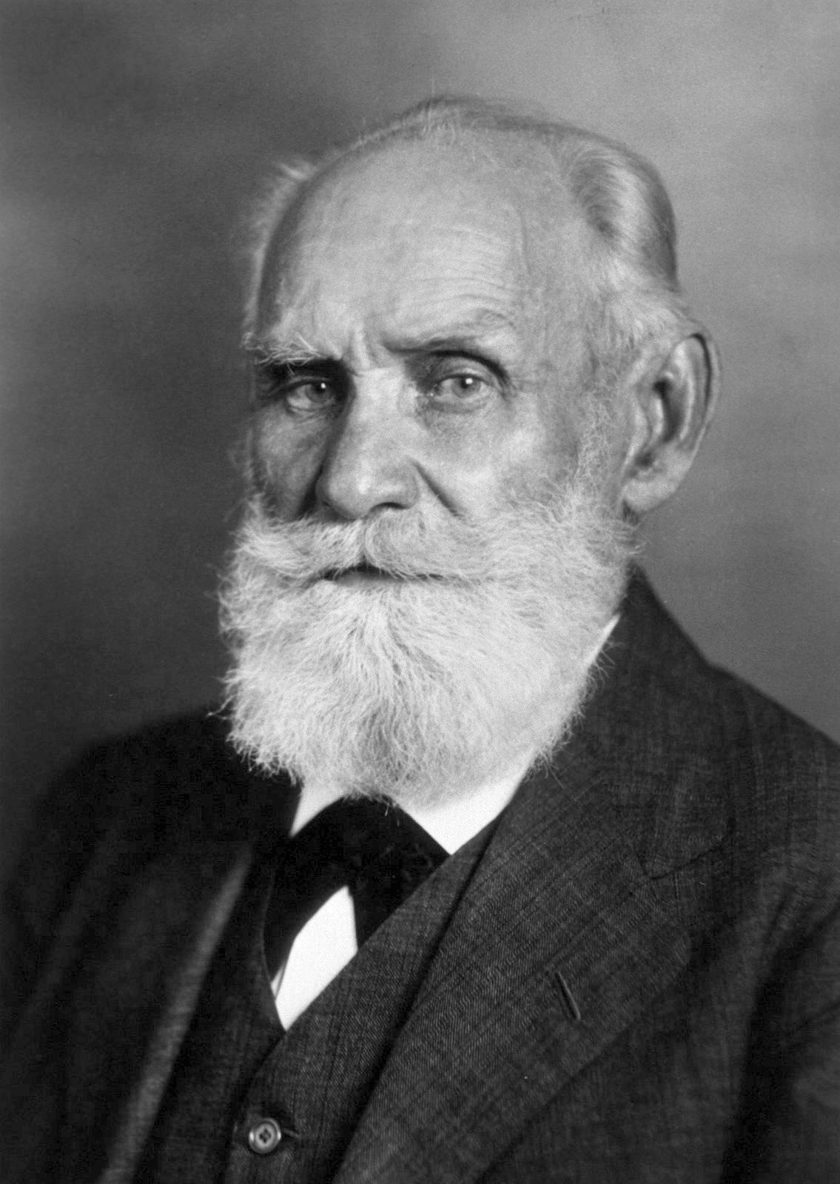
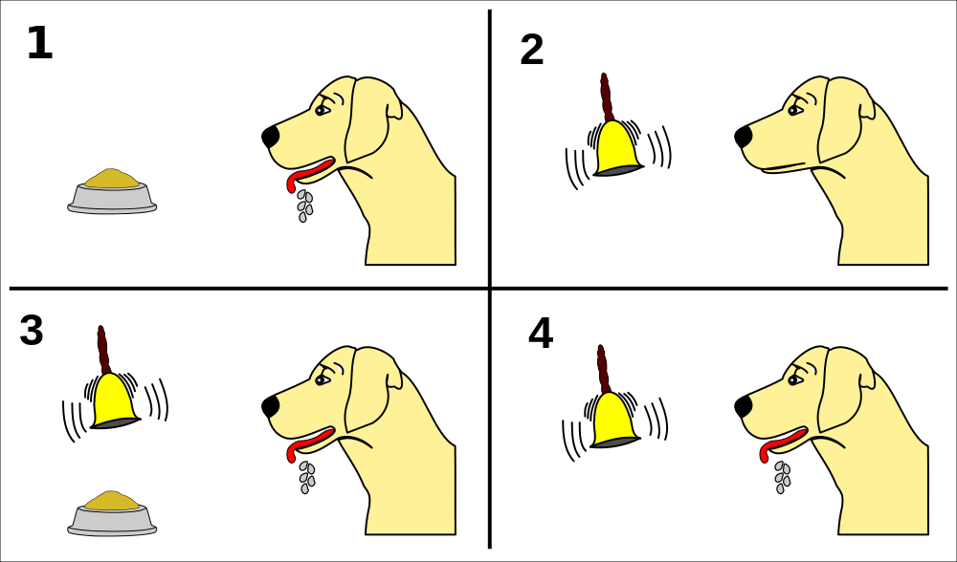
Ivan Pavlov 1849-1936
RESCORLA, R. A., 1988. Pavlovian Conditioning. American Psychologist, 43(3), 151–160
Notes:
Ivan Petrovich Pavlov was a Russian physiologist known primarily for his work in classical conditioning.

Slide 19
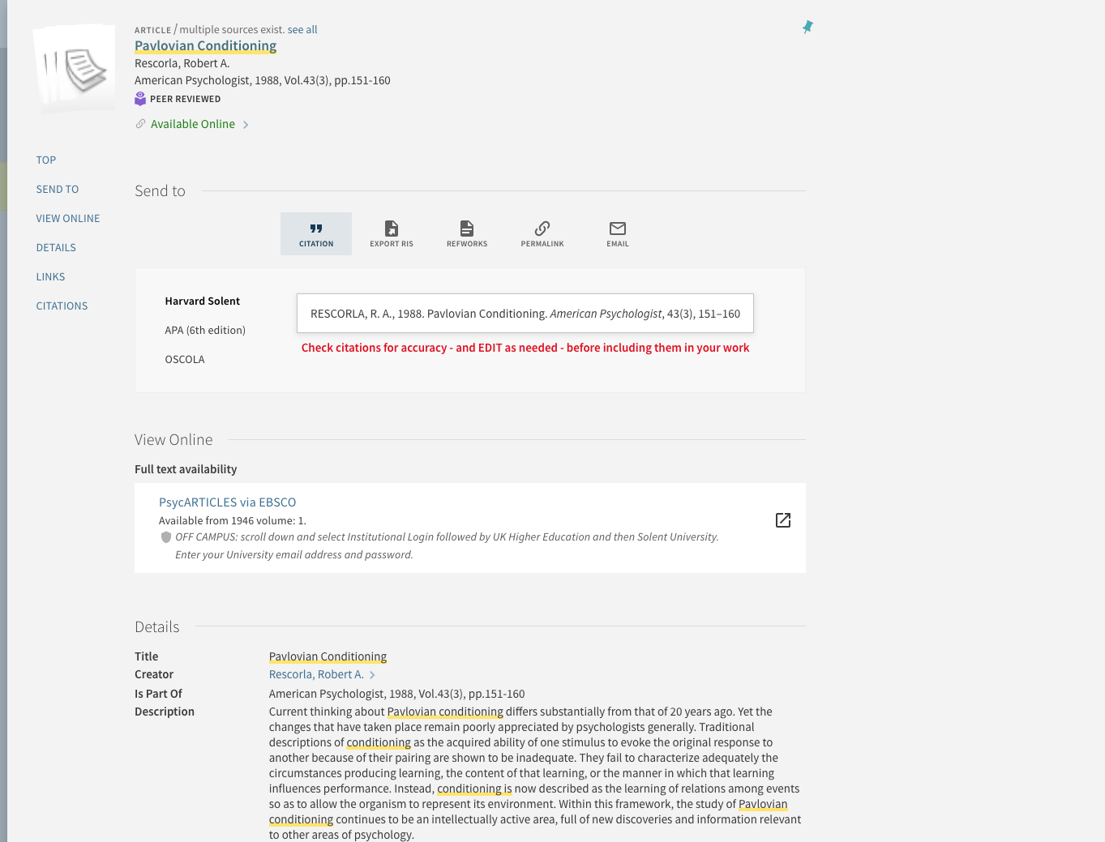
https://catalogue.solent.ac.uk/discovery/fulldisplay?docid=apa_articles10.1037/0003-066X.43.3.151&context=PC&vid=44SSU_INST:VU1&search_scope=MyInst_and_CI&tab=Combined&lang=en

Slide 20
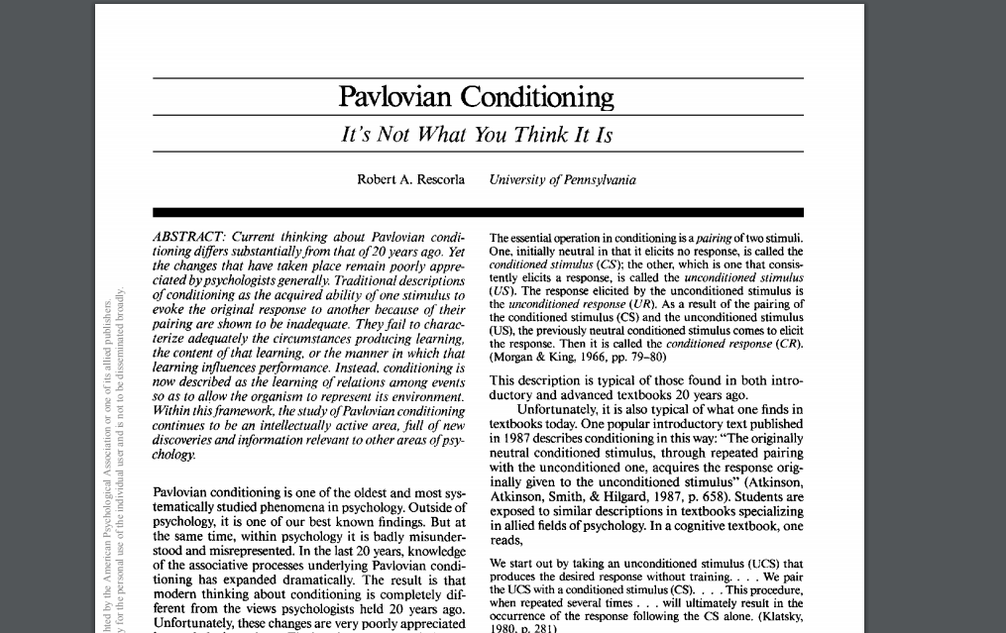

Slide 21
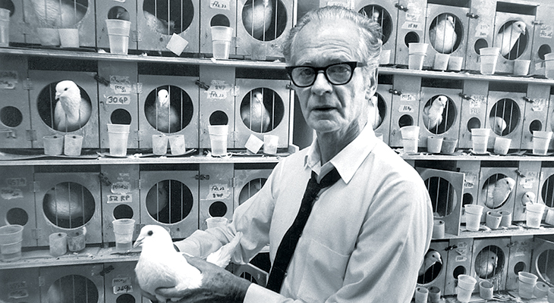
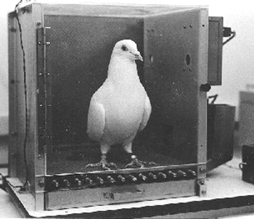
B. F. Skinner
Operant conditioning
GFA, n.d. Skinner and Behaviorism. In: Harvard University Brain Tour [viewed 6 October 2019]. Available from: https://braintour.harvard.edu/archives/portfolio-items/skinner-and-behaviorism

Slide 22
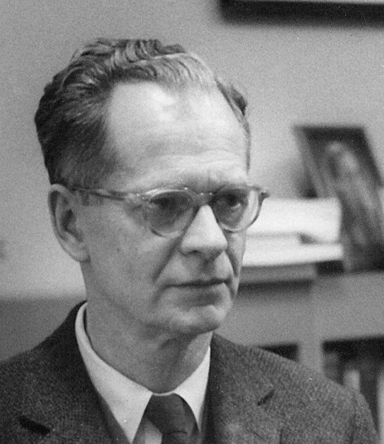
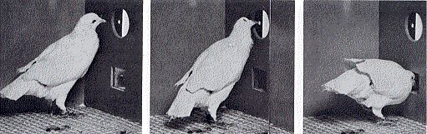
B. F. Skinner
Operant conditioning
The Skinner Box
SKINNER, B., 1992. ‘Superstition’ in the pigeon. Journal of Experimental Psychology: General, 121(3)
(This article is a reprint of an original work published in 1948 in the Journal of Experimental Psychology, 38, 168- 172.)
John Watson
https://www.simplypsychology.org/operant-conditioning.html
https://www.simplypsychology.org/classical-conditioning.html
Notes:
Operant conditioning is a method of learning that occurs through rewards and punishments for behavior. Through operant conditioning, an individual makes an association between a particular behavior and a consequence (Skinner, 1938).

Slide 23
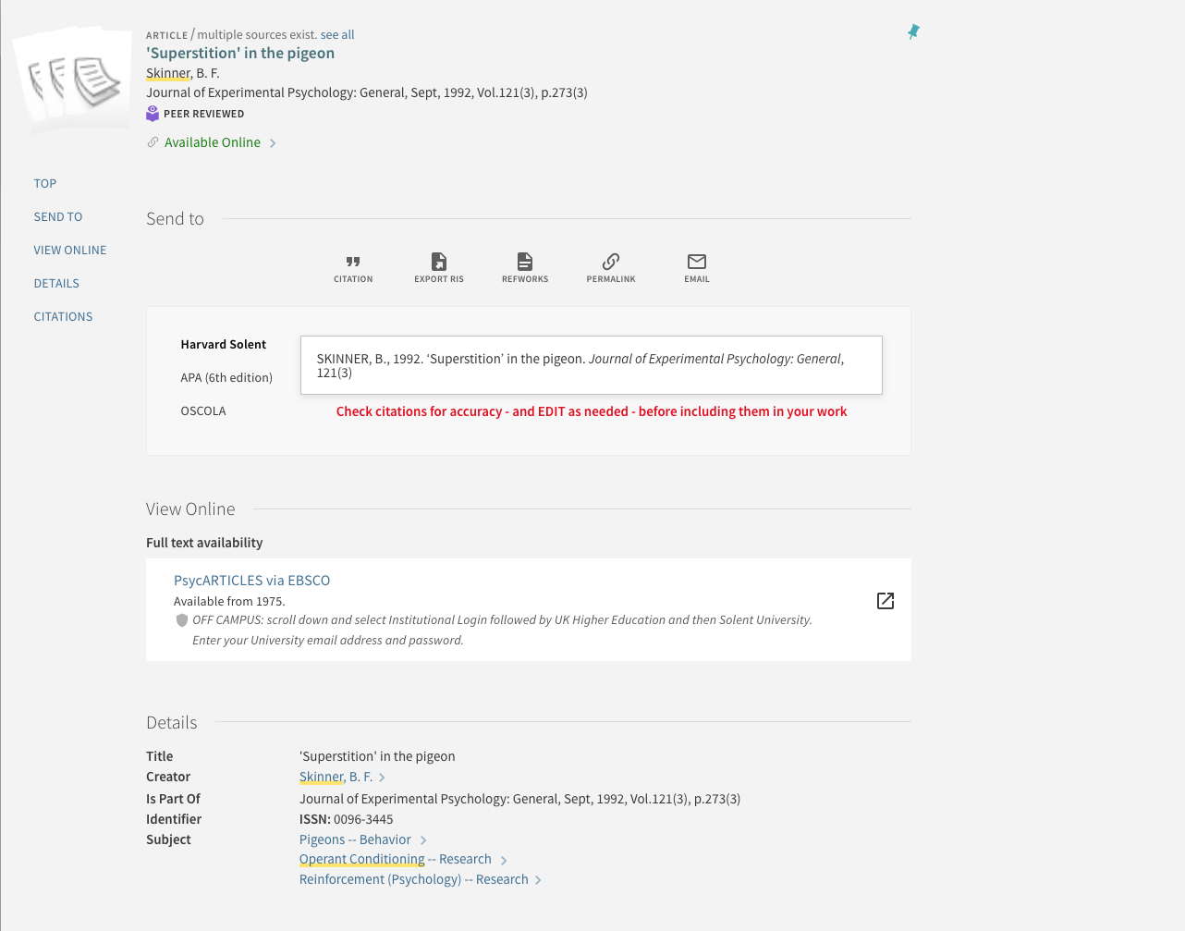
https://catalogue.solent.ac.uk/discovery/fulldisplay?docid=gale_hrca12940239&context=PC&vid=44SSU_INST:VU1&search_scope=MyInst_and_CI&tab=Combined&lang=en

Slide 24
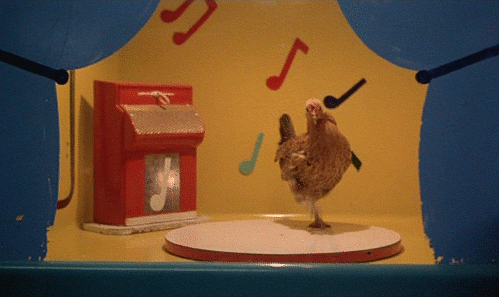
Stroszek, 1977. Directed by Werner HERZOG. Leipzig: Werner Herzog Filmproduktion

Slide 25
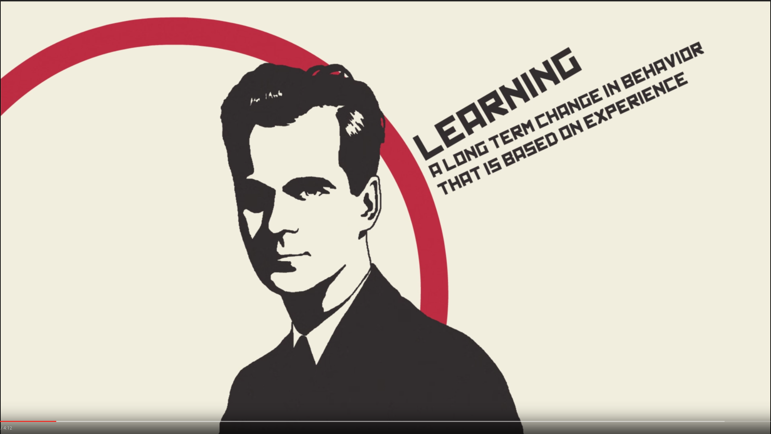
The difference between classical and operant conditioning - Peggy Andover [viewed Aug 20, 2017]. Available from: https://www.youtube.com/watch?v=H6LEcM0E0io

Slide 26
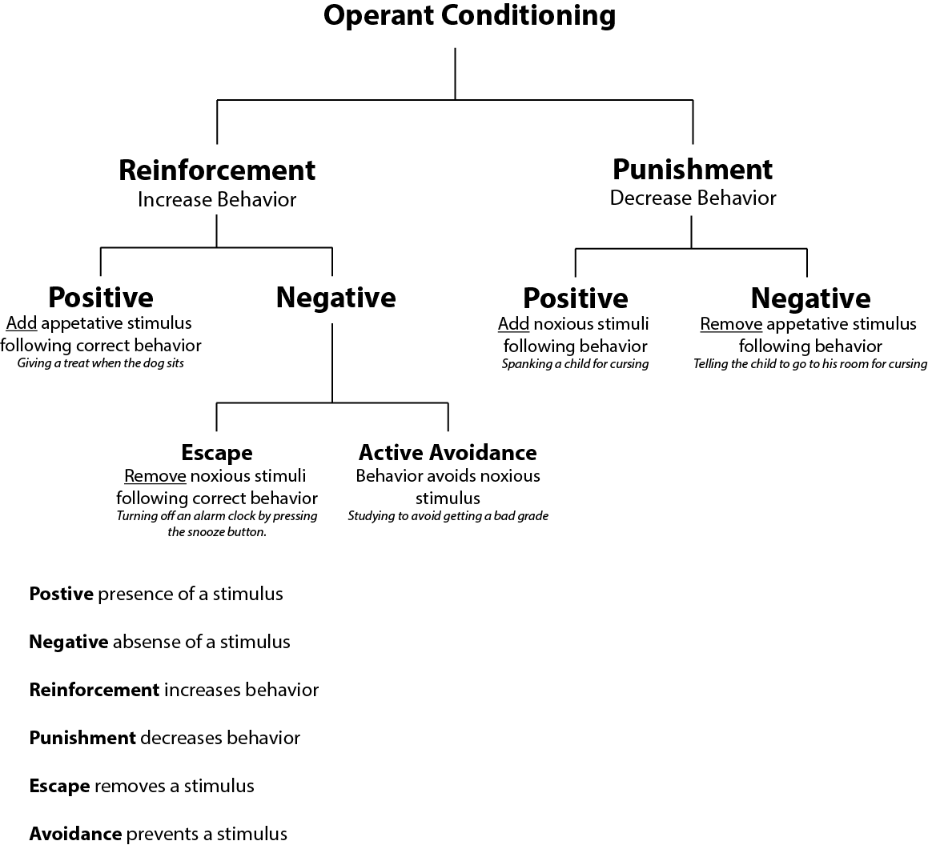
Comparison of Classical and Operant Conditioning

Slide 27
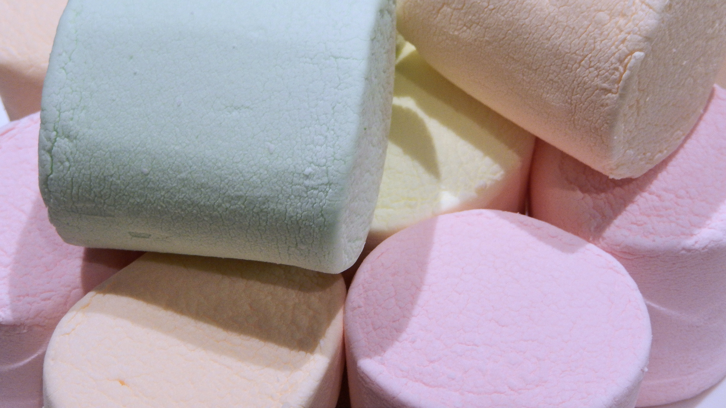
THE MARSHMALLOW TEST

Slide 28

The Marshmallow Test [viewed Aug 20, 2017]. Available from: https://www.youtube.com/watch?v=QX_oy9614HQ

Slide 29
“Those 4-year-old children who delayed gratification longer in certain laboratory situations developed into more cognitively and socially competent adolescents, achieving higher scholastic performance and coping better with frustration and stress.”
MISCHEL, W., et al, 1989. Delay of gratification in children. Science, 244(4907), 933–938. https://search.proquest.com/docview/213543080/fulltextPDF/AEDF681918414F8EPQ/1?accountid=13969

Slide 30
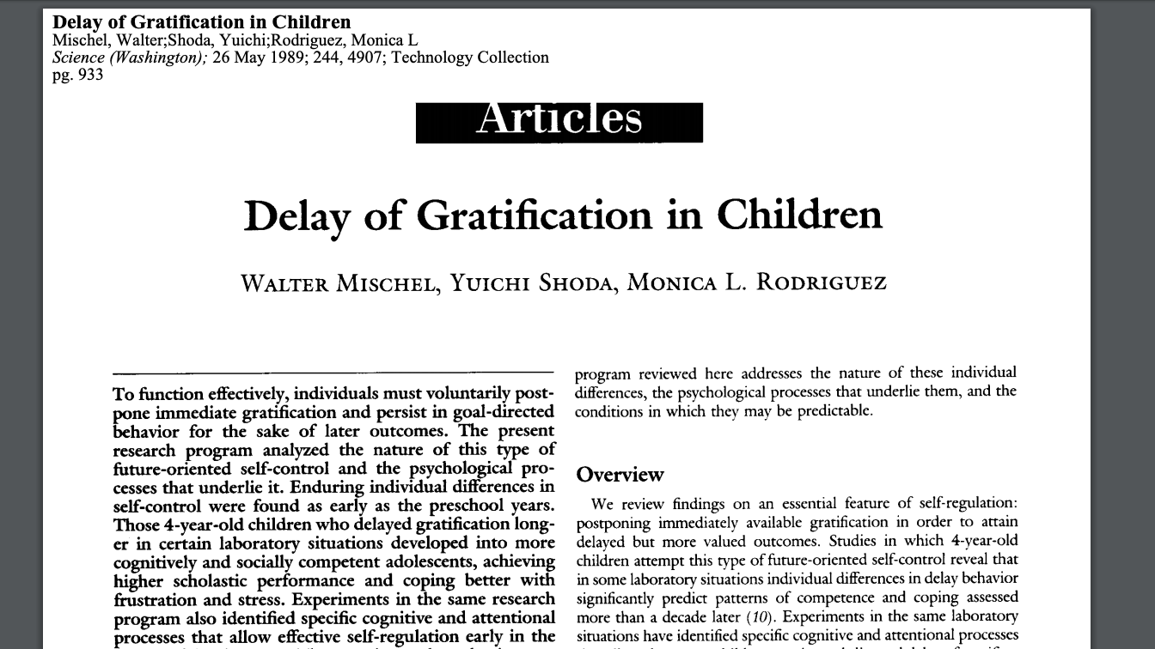

Slide 31

https://catalogue.solent.ac.uk/discovery/fulldisplay?docid=gale_hrca7658375&context=PC&vid=44SSU_INST:VU1&lang=en&search_scope=MyInst_and_CI&adaptor=Primo%20Central&tab=Combined&query=any,contains,Delay%20of%20gratification%20in%20children&offset=0

Slide 32
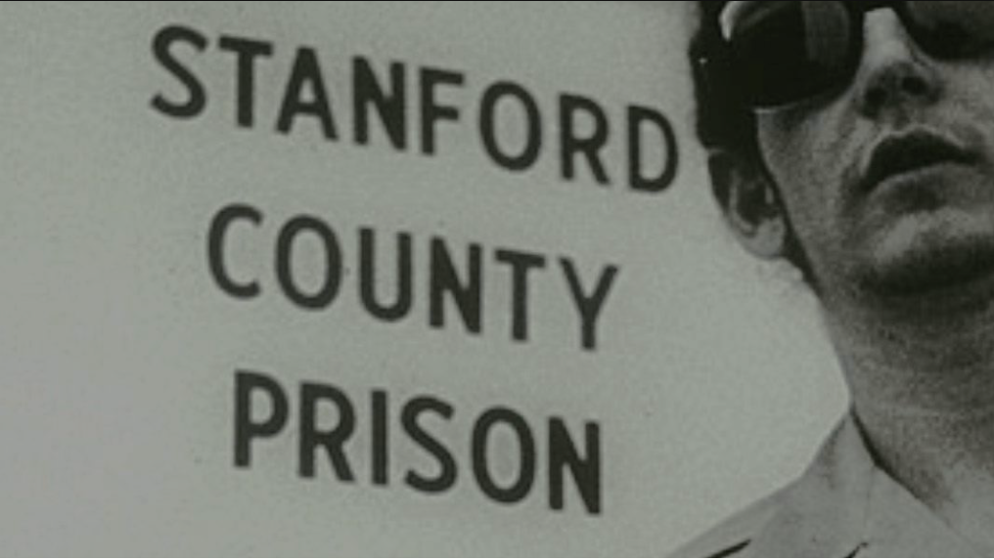
PRISONEXP.ORG., 2019. Stanford Prison Experiment [viewed 6 October 2019]. Available from: https://www.prisonexp.org

Slide 33
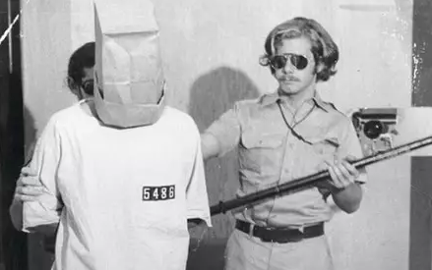
The Stanford Prison Experiment 1973
Purpose of the Study “Zimbardo and his colleagues were interested in finding out whether the brutality reported among guards in American prisons was due to the sadistic personalities of the guards (i.e., dispositional) or had more to do with the prison environment (i.e., situational).”
MCLEOD. S., 2019. Stanford Prison Experiment | Simply Psychology [viewed 6 October 2019]. Available from: https://www.simplypsychology.org/zimbardo.html

Slide 34
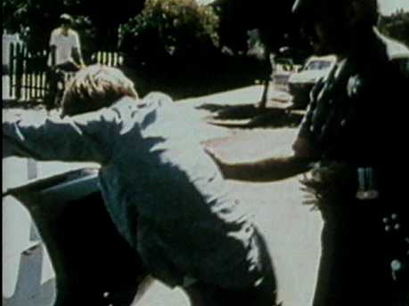
Zimbardo Stanford Prison Experiment 1 1, n.d. [film] [viewed 6 October 2019]. Available from: https://www.youtube.com/watch?v=hIUlBrvqyyo

Slide 35
Conclusion
“Zimbardo's Stanford prison experiment revealed how people will readily conform to the social roles they are expected to play, especially if the roles are as strongly stereotyped as those of the prison guards.”
PRISONEXP.ORG., 2019. Stanford Prison Experiment [viewed 6 October 2019]. Available from: https://www.prisonexp.org

Slide 36
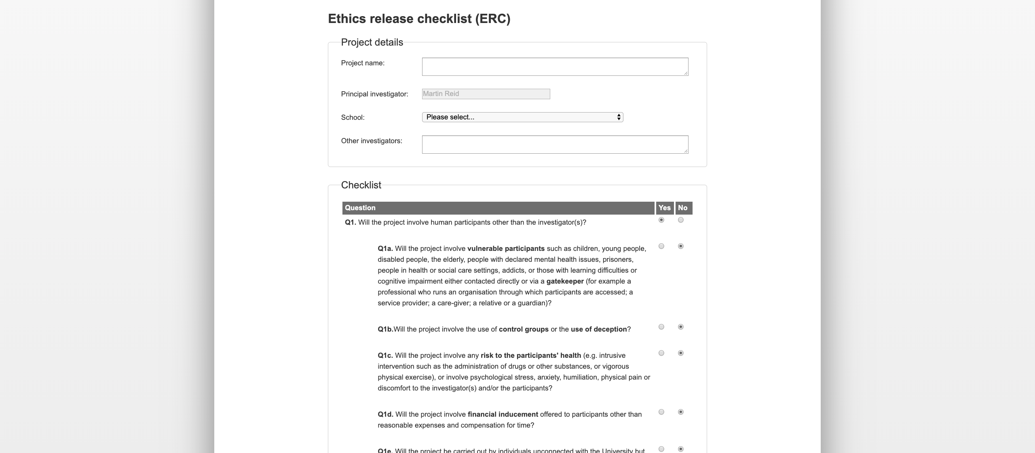

Slide 37
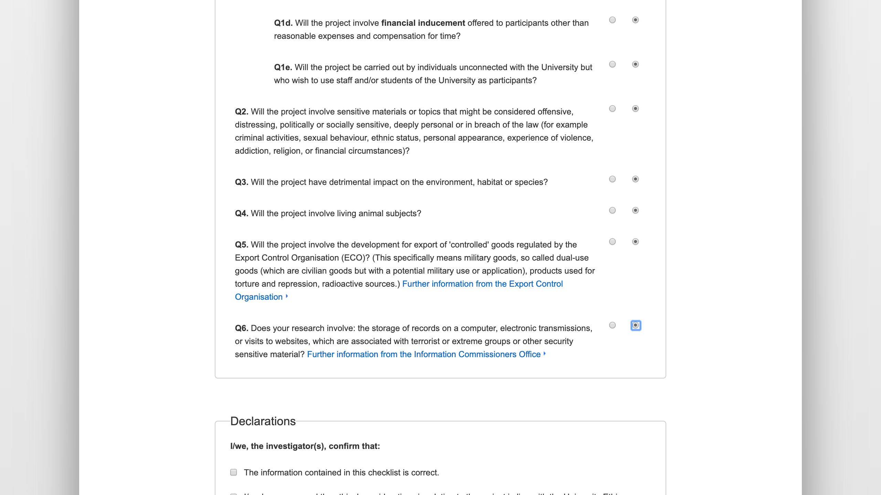

Slide 38
